Slide 1
Abusive Language Detection from Multimodal Content using Transformers
Course No. : CSE-400
Course Title: Project and Thesis
Presented By
Ashraful Islam Paran
1904029
Supervised By
Dr. Mohammed Moshiul Hoque
Professor
Dept. of CSE, CUET

Slide 2
Contents
Introduction
Motivation
Challenge
Objective
Related Work
Research Gap
Methodology
Conclusion

Slide 3
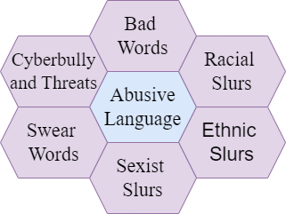
Introduction
The term “Abusive language” [1] includes-
Bad words
Racial, ethnic and sexist slurs
Swear words
Cyberbully and threats

Slide 4
Introduction (Cont.)
Transcript: নইলে তোকে আমি জিন্দা পুতে ফেলব শুয়োরের বাচ্চা
Class: Abusive
Transcript: আমি এখন ইউটিউব এর সিঙ্গাপুর অফিসের সরাসরি ভিতরে
Class: Non-Abusive

Slide 5
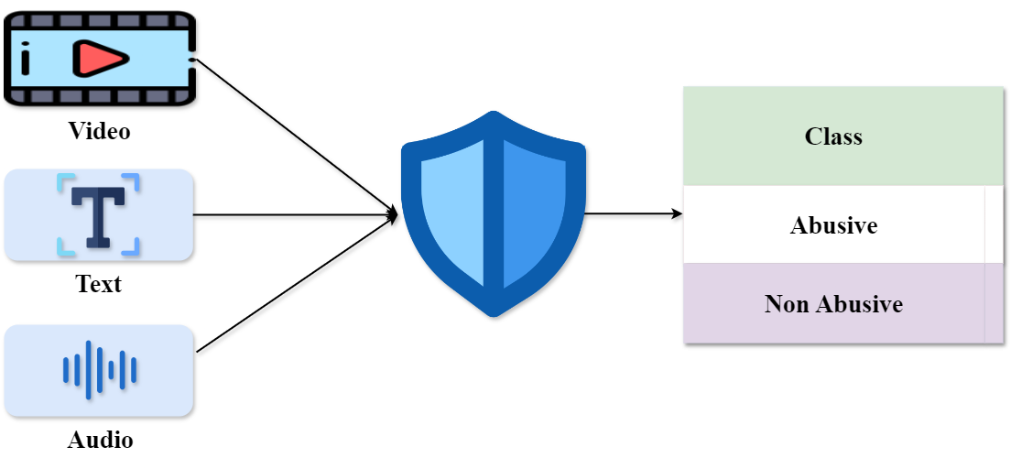
Introduction (Cont.)
Figure 1: Overview of Abusive Language Detection

Slide 6
Motivation
Significant advancements have been made in multimodal abusive language detection for English, but a clear gap remains for low-resource languages, such as Bangla.
No work in Bengali addressed three modalities (audio, video, and text) to detect abusive language.

Slide 7
Challenge
Difficulty in data acquisition
Abusive words are beeped in many online media
Abusive language videos are removed from video platforms for community guidelines violation
Difficulty in model building
Combining data from various modalities (text, audio, video) into a single coherent representation

Slide 8
Objective
To develop a Multimodal Abusive Language Dataset
To develop a multimodal framework for abusive language detection in videos by combining textual, audio and video features.

Slide 9
Related Work
Abusive Bangla comments detection [2] (Aurpa et al., 2021)
Dataset consists of comprises 44,001 Bengali texts
ELECTRA-Base
F1 score of 0.84
Limitations:
Only textual modality
Low F1 score

Slide 10
Related Work (Cont.)
Abusive Speech Detection in Indic Languages [3] (Spiesberger et al., 2024)
Dataset consists of 11,775 audio recordings
OPENSMILE + RF
F1 score of 0.76
Limitations:
Only audio modality
Low F1 score

Slide 11
Related Work (Cont.)
Multimodal Abusive Language Detection in Tamil and Malayalam [4] (Premjith et al., 2023)
Dataset consists of 78 video clips in Tamil and Malayalam
Text, audio and video
F1 score of 0.71
ConvLSTM + BiLSTM + MNB
Limitations:
Very small dataset
Low F1 score

Slide 12
Related Work (Cont.)
Toxicity Detection in Code-Mixed Videos [5] (Maity et al., 2024)
Dataset consisting of 931 videos
Text, audio and video
Roberta + Whisper + VideoMAE
F1 score of 0.94
Limitation:
Hindi language only

Slide 13
Research Gap
How can transformer-based models be adapted to effectively fuse and detect abusive language across text, audio, and video modalities in Bangla content?
How can a newly developed multimodal dataset be leveraged to improve the accuracy of abusive language detection?

Slide 14
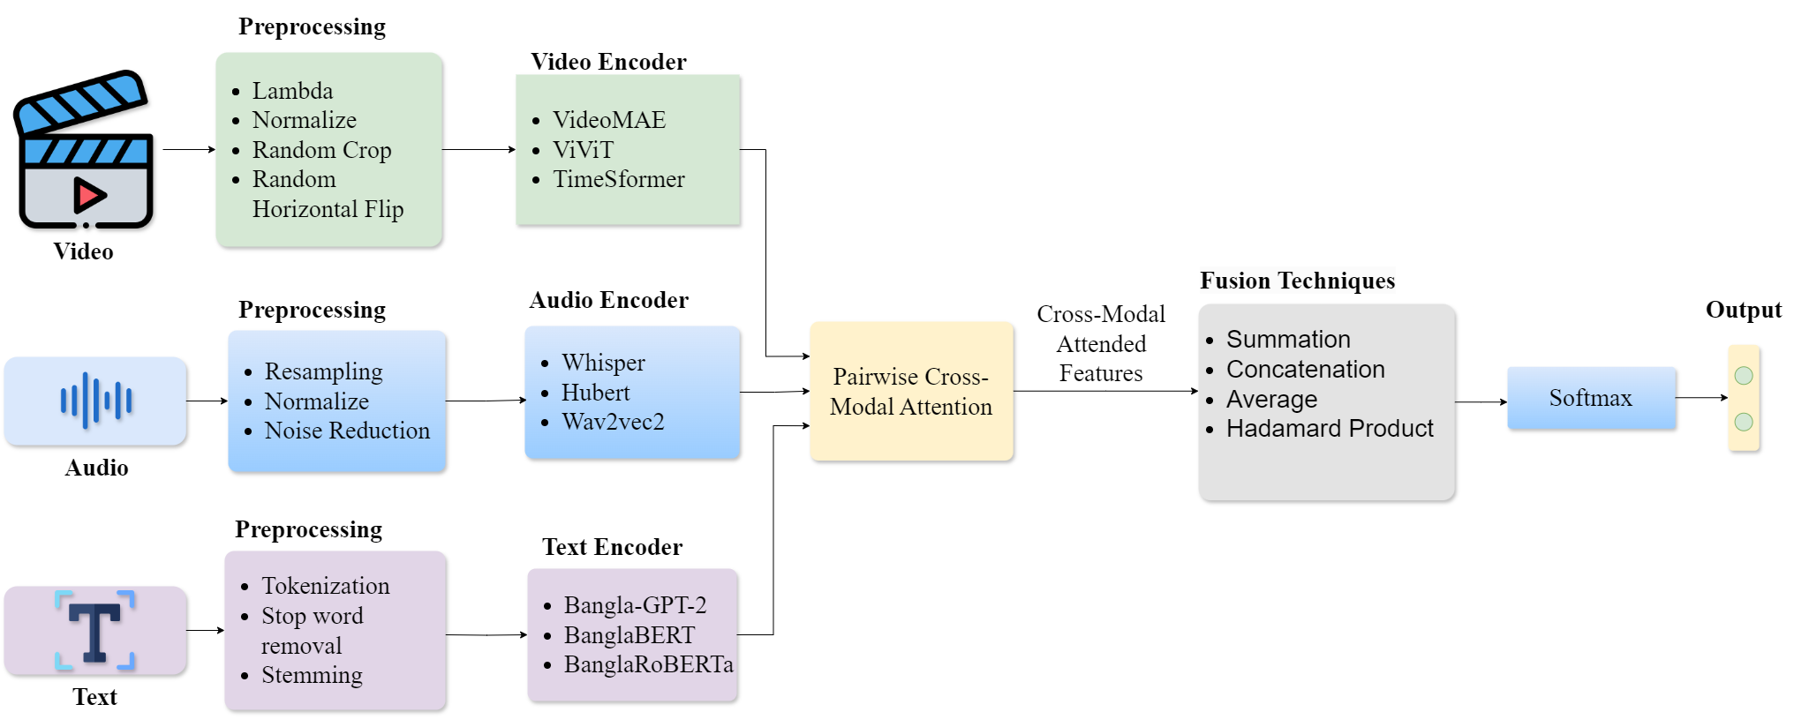
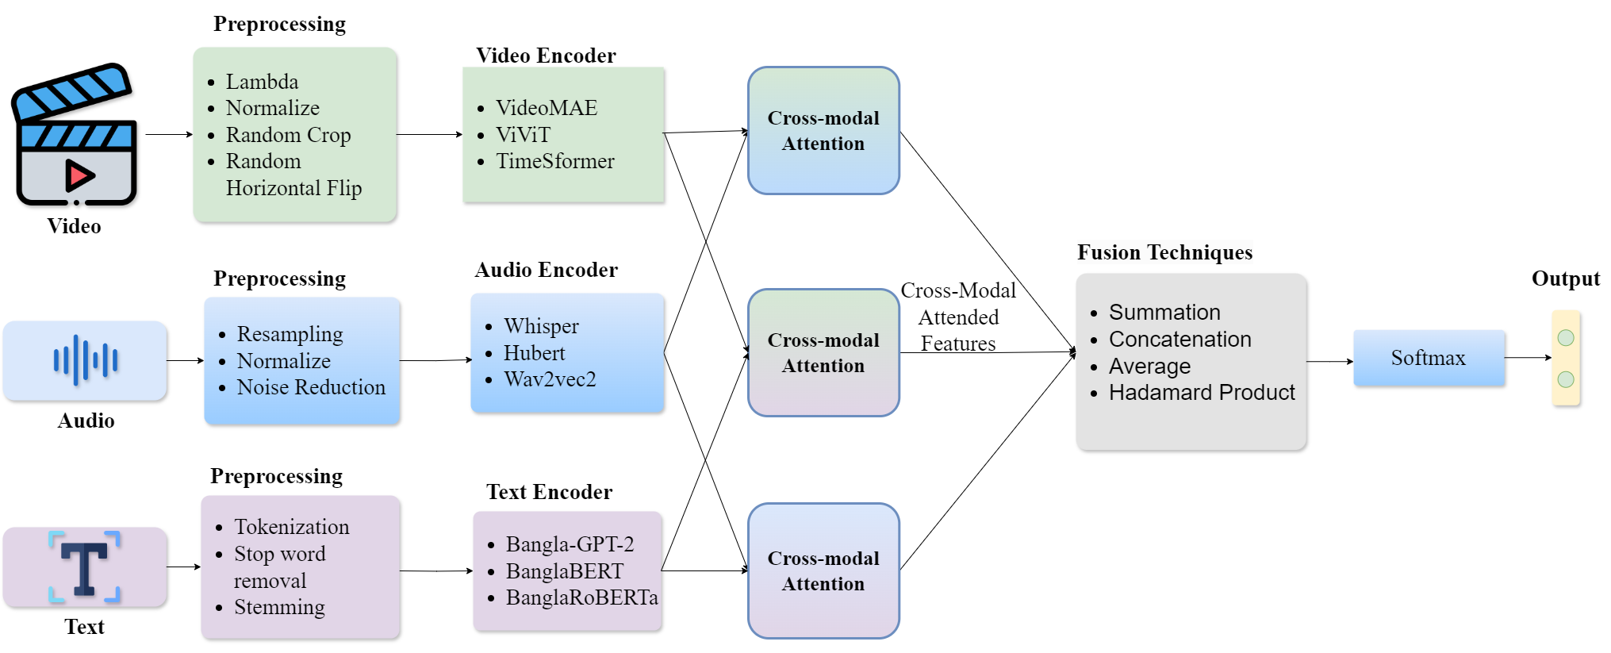

Methodology
Figure 3: Abstract View of Methodology

Slide 15
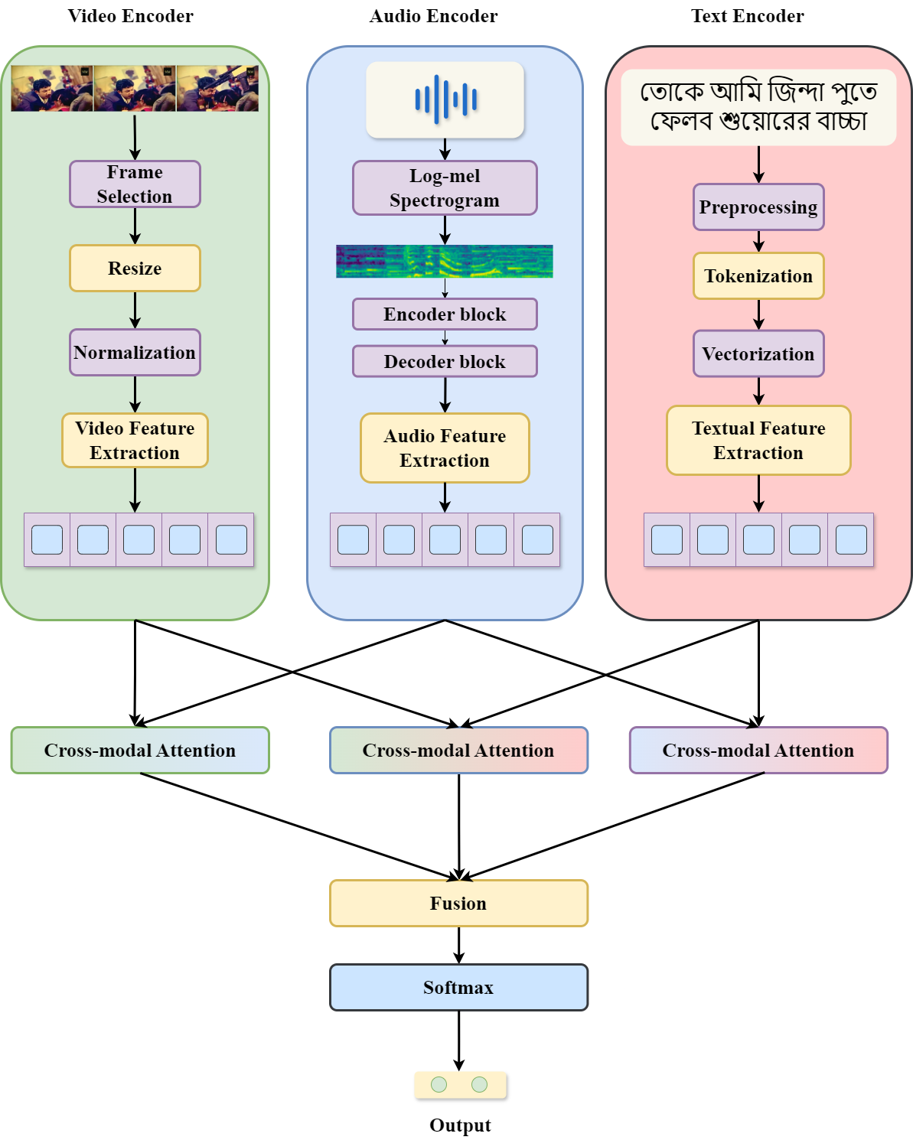
Methodology
Figure 4: Detailed view of Methodology

Slide 16
Conclusion
A multimodal dataset will be developed for abusive language detection
A multimodal framework will be developed for abusive language detection in videos
Several transformer-based models and fusion techniques will be investigated to find the state-of-the-art model

Slide 17
References
[1] Kaur, S., Singh, S., & Kaushal, S. (2021). Abusive content detection in online user-generated data: a survey. Procedia Computer Science, 189, 274-281.
[2] Aurpa, T. T., Sadik, R., & Ahmed, M. S. (2022). Abusive Bangla comments detection on Facebook using transformer-based deep learning models. Social Network Analysis and Mining, 12(1), 24.
[3] Spiesberger, A. A., Triantafyllopoulos, A., Tsangko, I., & Schuller, B. W. (2024). Abusive Speech Detection in Indic Languages Using Acoustic Features. arXiv preprint arXiv:2407.20808.

Slide 18
References
[4] Premjith, B., Sowmya, V., Chakravarthi, B. R., Natarajan, R., Nandhini, K., Murugappan, A., ... & Sn, P. (2023, September). Findings of the shared task on multimodal abusive language detection and sentiment analysis in tamil and malayalam. In Proceedings of the Third Workshop on Speech and Language Technologies for Dravidian Languages (pp. 72-79).
[5] Krishanu Maity, Poornash Sangeetha, Sriparna Saha, and Pushpak Bhattacharyya. 2024. ToxVidLM: A Multimodal Framework for Toxicity Detection in Code-Mixed Videos. In Findings of the Association for Computational Linguistics ACL 2024, pages 11130–11142, Bangkok, Thailand and virtual meeting. Association for Computational Linguistics.

Slide 19
Thank
You

